Slide 1
Chapter 6 – Models
Artificial Intelligence

Slide 2
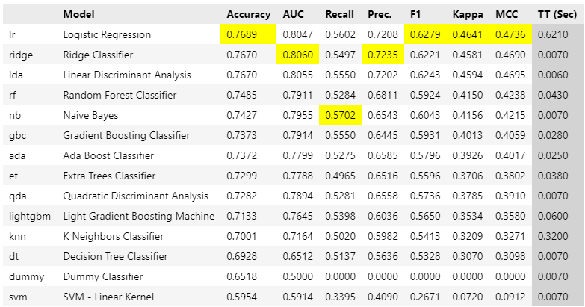
Models
As PyCaret showed us, there are quite a lot of models out there

Slide 3
How good is the model?
The model should generalize to unseen data
If you are using it to predict
If it’s just to explain the data overfitting isn’t a problem
Split up the given dataset:
Build model on training dataset (e.g. 70%)
Test model using test set (remaining 30%)
Calculate RMSE (or recall) on both datasets
Check that the RMSE on training is as low as it can be, but that the RMSE of test isn’t significantly higher
Notes:
RMSE: see later

Slide 4
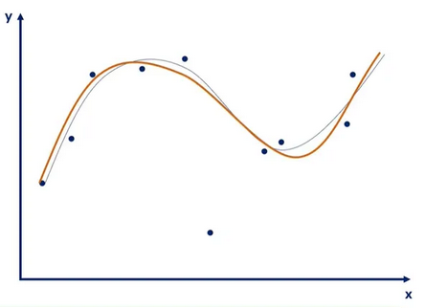
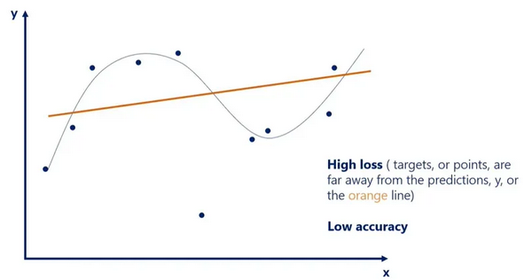
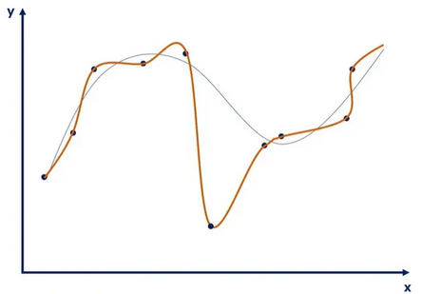
Overfitting and underfitting
Good model
Line follows datapoints correctly
Obvious outliers are ignored
Underfitting
Line only vaguely follows datapoints
Outliers are ignored, but some data points too
Is equally bad with unseen data as with trained data
Can be a bad model, but also not enough training
Overfitting
Line follows datapoints exactly
Outliers are taken very much into account
Does not generalize to unseen data
Model too complex, or too much training
Notes:
https://365datascience.com/tutorials/machine-learning-tutorials/overfitting-underfitting/

Slide 5
Overfitting and underfitting
Overfitting and underfitting are measured using the RMSE
In the example in the previous slide we’re not using a linear regression but a polynomial regression
The question we are asking is how many polynomials we should be using
A 17th-order function will have 17 zero-crosses, so will follow the data very well, but have next to no explainability
It will also follow the data it is given, so the training data (which is the reason we kept some data secret in the test-set)

Slide 6
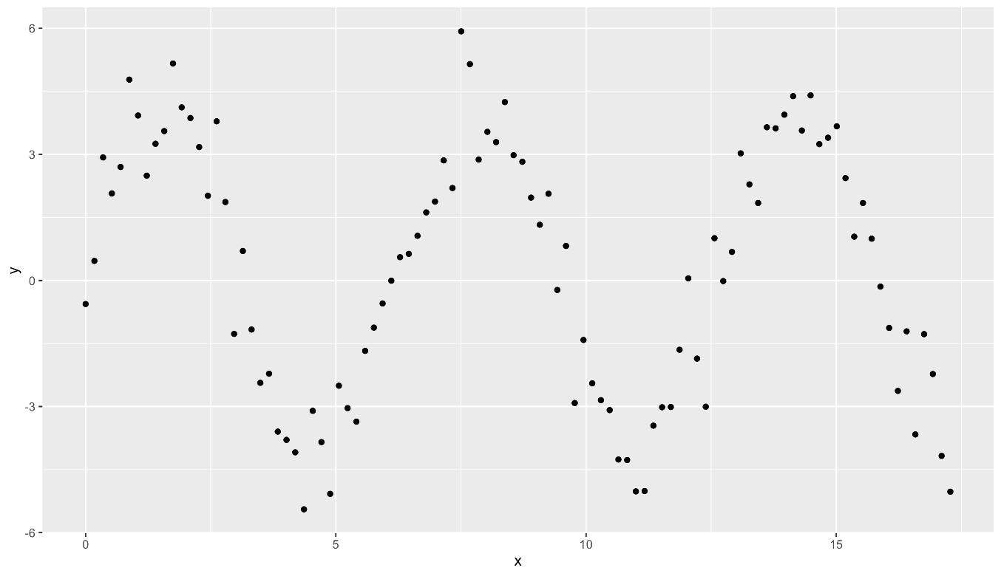
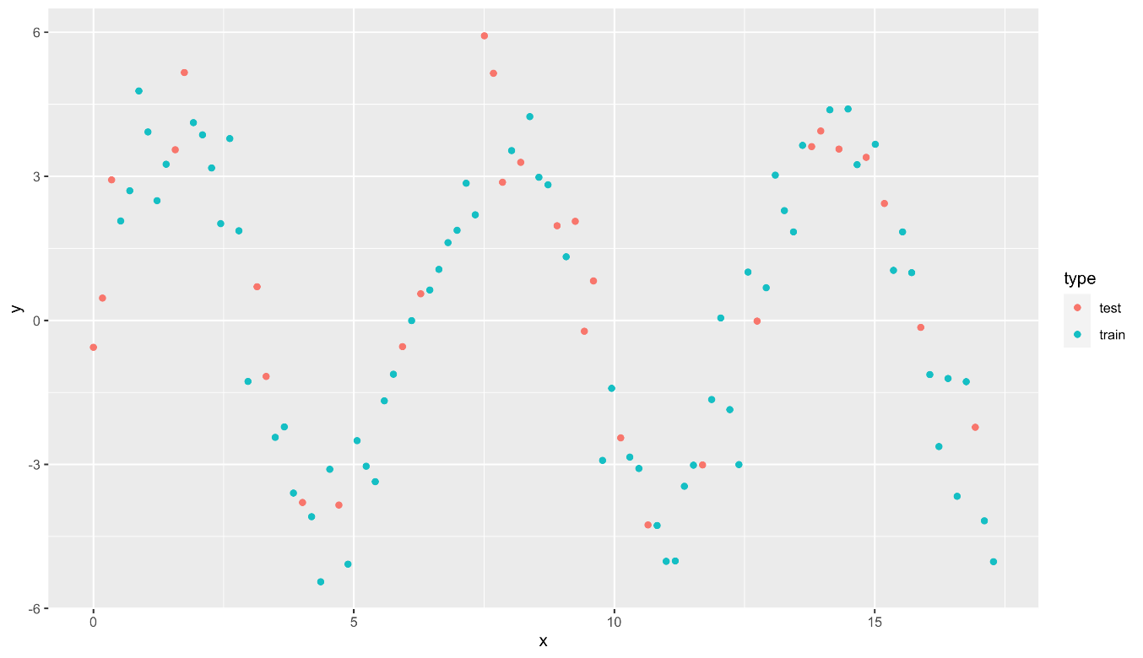
Modeling more complex patterns
A classical linear model will not do!

Slide 7
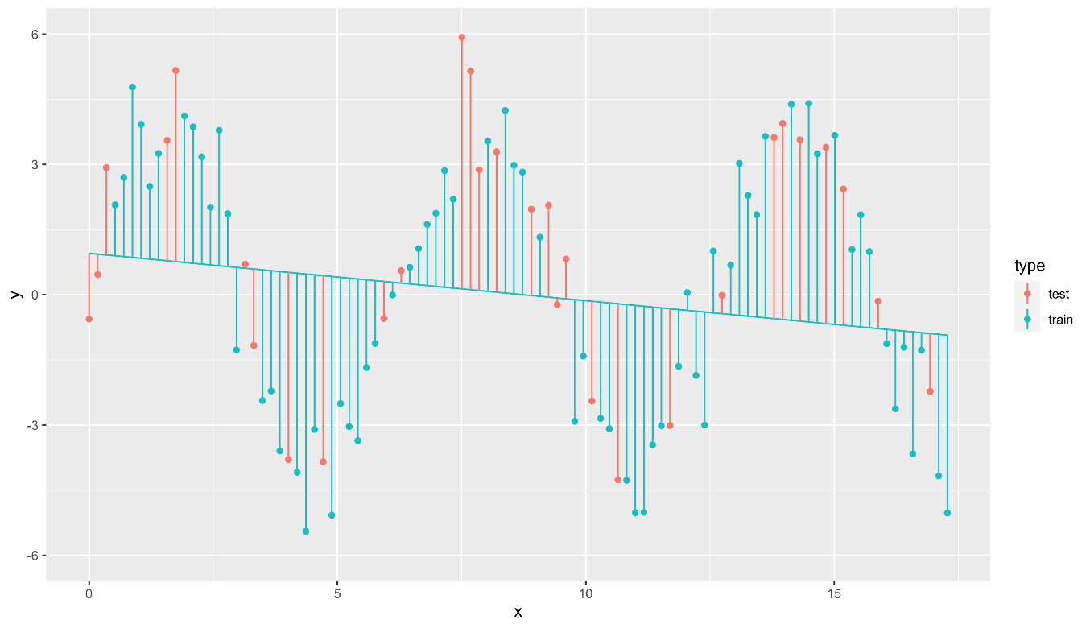
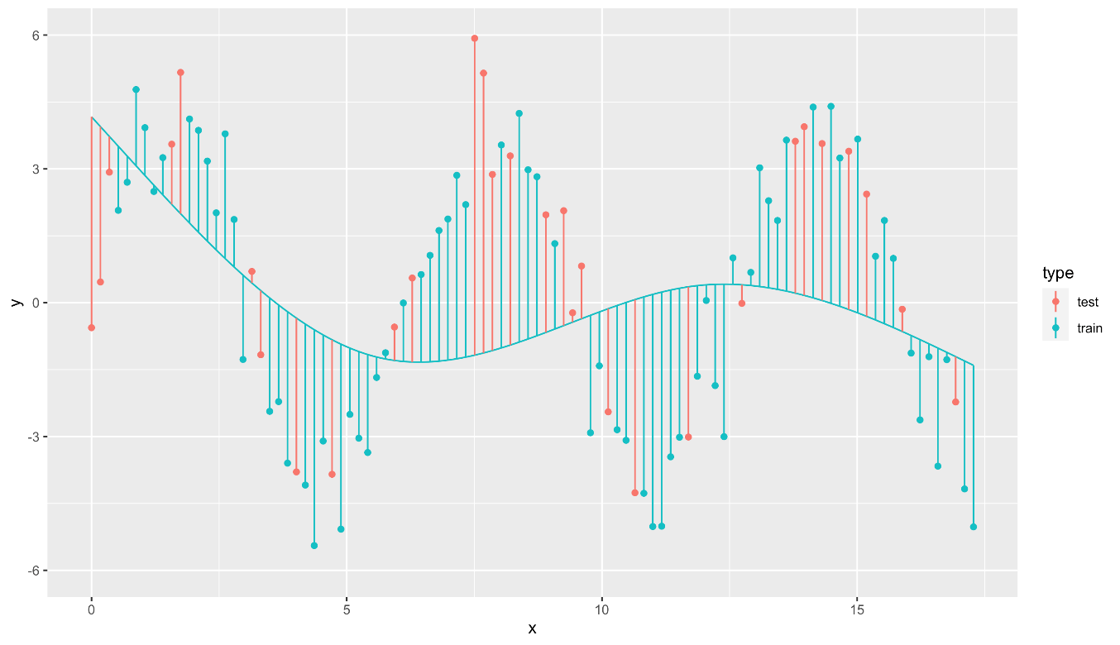
Modeling more complex patterns
Natural spline with 1 degrees of freedom
Natural spline with 3 degrees of freedom
RMSE_train = 2.971
RMSE_test = 3.020
RMSE_train = 2.779
RMSE_test = 3.204

Slide 8
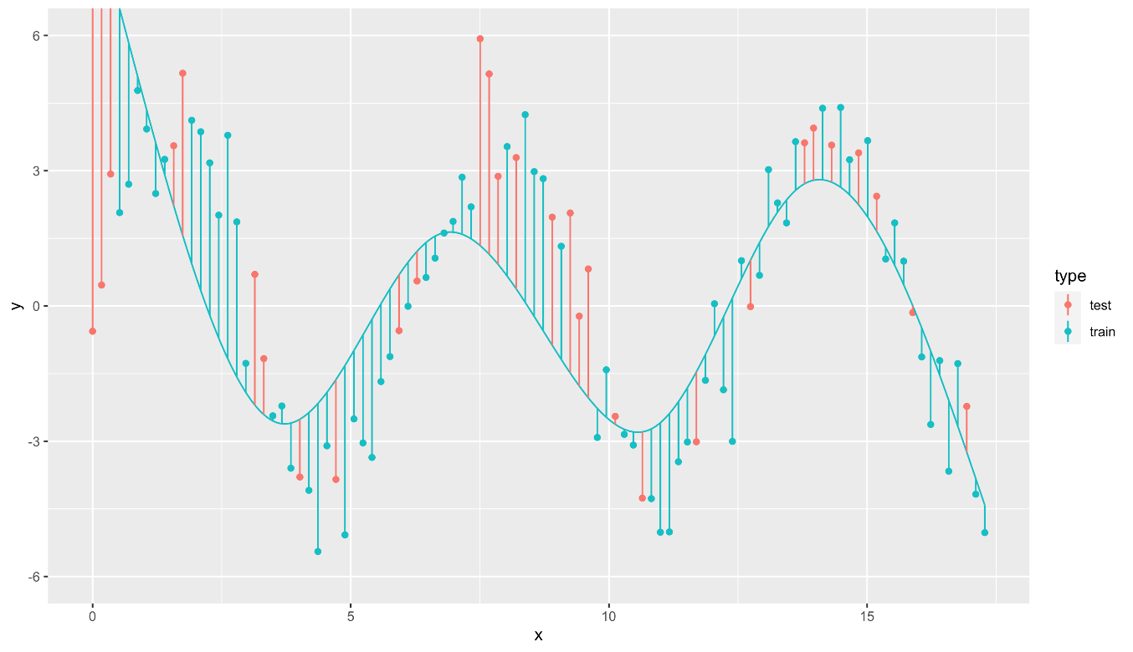
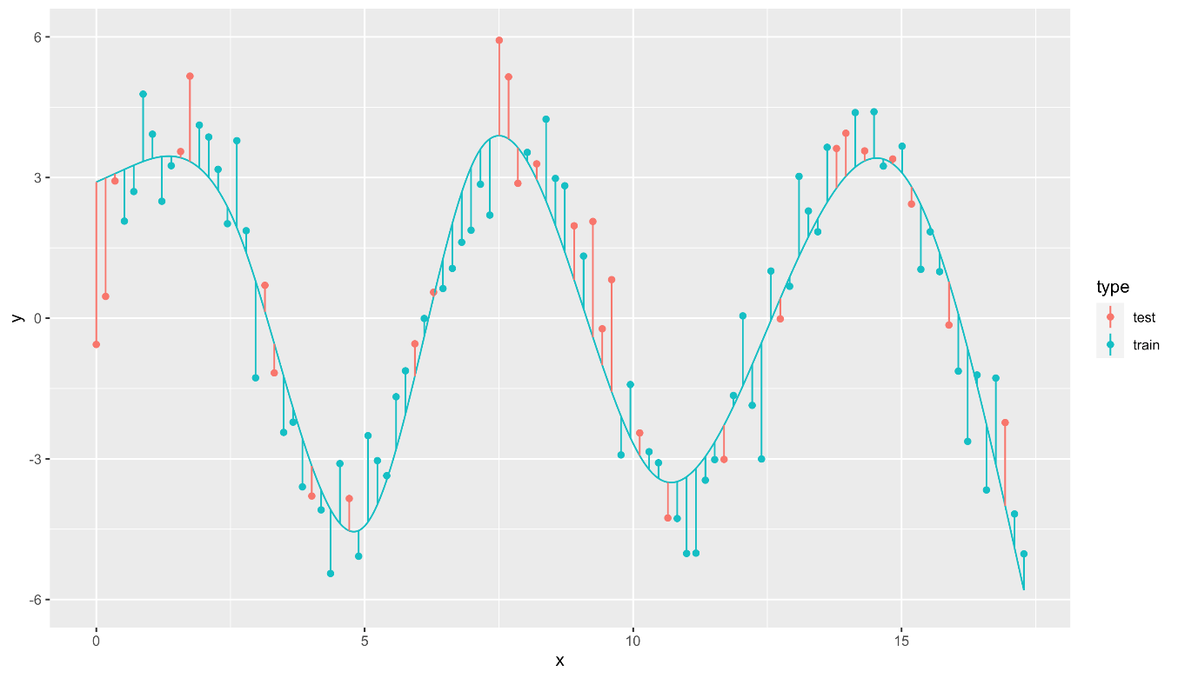
Modeling more complex patterns
Natural spline with 5 degrees of freedom
Natural spline with 7 degrees of freedom
RMSE_train = 1.988
RMSE_test = 3.120
RMSE_train = 1.092
RMSE_test = 1.310

Slide 9
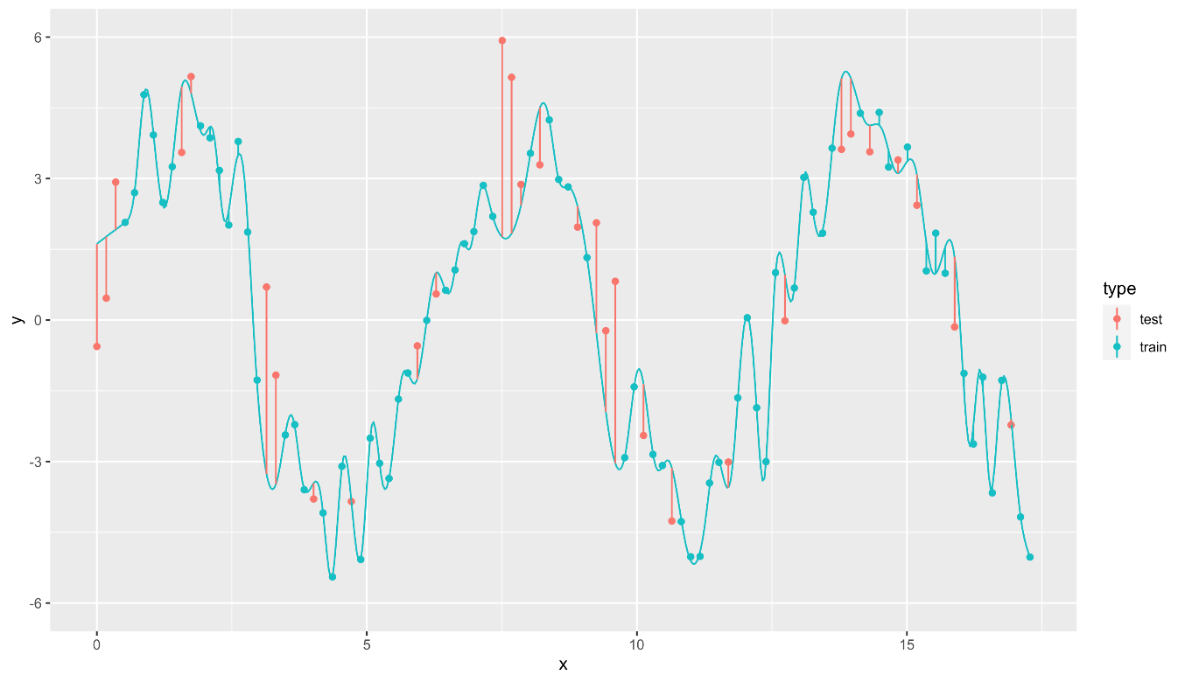
Modeling more complex patterns
Natural spline with 65 degrees of freedom
RMSE_train = 0.189
RMSE_test = 1.783
Error on training is low, but error on test set is much higher Model does not generalize well.

Slide 10
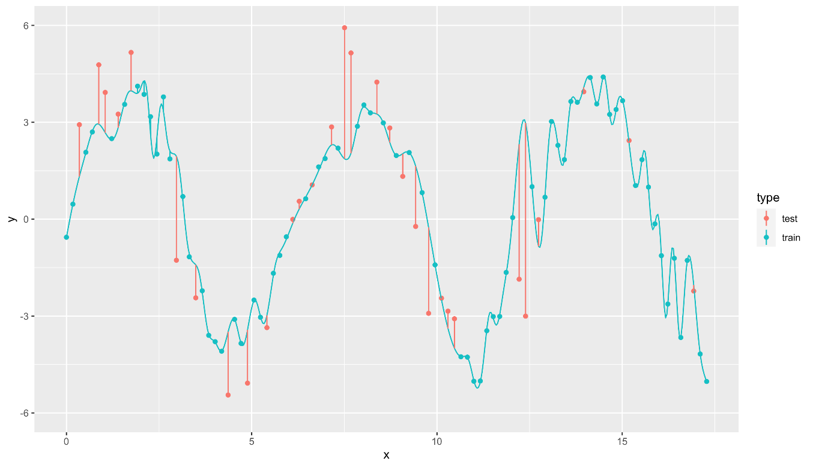
Sensitivity to train/test split
Natural spline with 65 degrees of freedom,
train/test split v1
Natural spline with 65 degrees of freedom train/test split v2
Also called variance: error from sensitivity to small fluctuations in the training set

Slide 11
Under- and overfitting
Natural spline with 3 degrees of freedom
Natural spline with 65 degrees of freedom
Underfitting
Model is not complex enough
Overfitting
Model is too complex
Model is too sensitive to the training data Model does not generalize well

Slide 12
The bias-variance tradeoff
High bias
Low variance
Low bias
High variance
Notes:
High bias: model is bad for the data
Low variance: Another train/test-split would have given roughly the same model
Low bias: Model is really well fitted to the data
High variance: Another train/test-split would have given a very different model

Slide 13
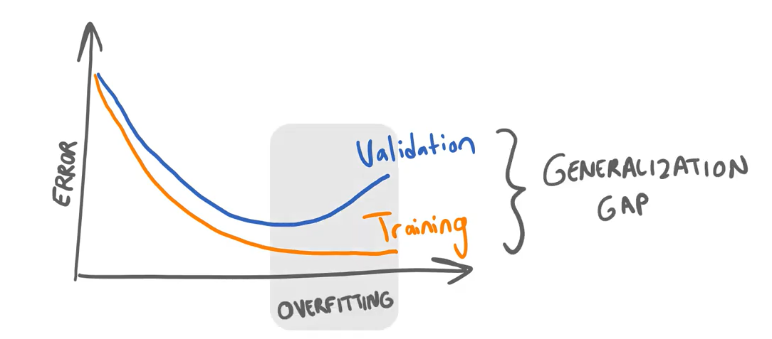
How to find the sweet spot?
Not allowed to use the test set!
Split up dataset in 3 parts
Build model on training set (60%)
Check complexity against validation set (20%)
Verify quality on test set (20%)

Slide 14
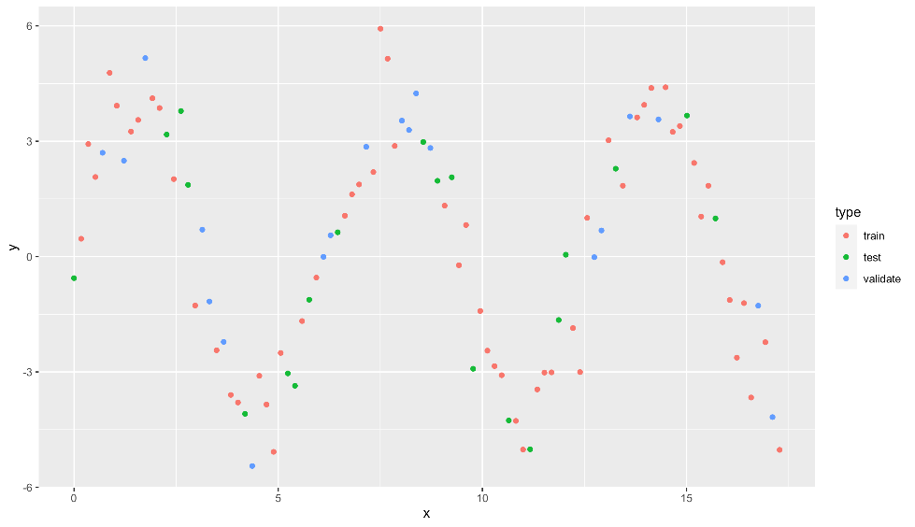
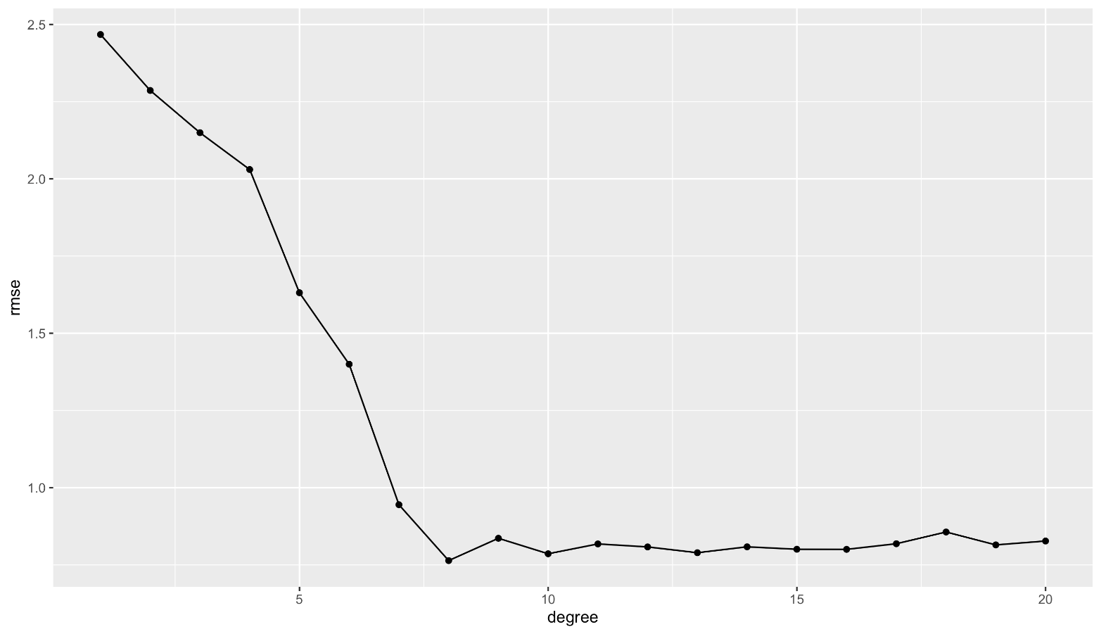
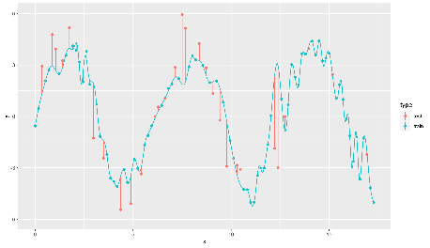
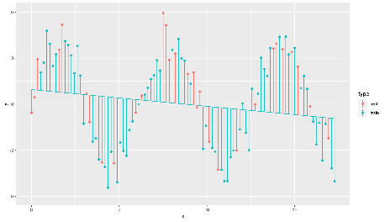
Divide data in three subsets Track RMSE as complexity increases
Low bias High variance
Sweet spot OK bias OK variance
High bias Low variance
No improvement

Slide 15
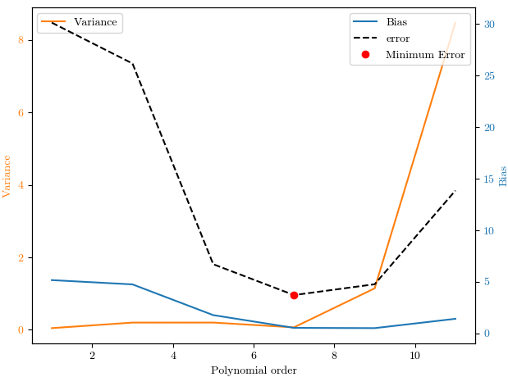
6.1 - Bias variance tradeoff
For clean and large enough dataset:
The greater the model complexity the lower the estimation error, the better the approximation.
The greater the model complexity the lower the bias
The greater the model complexity the lower the variance
For noisy dataset:
Greater model complexity doesn’t mean lower estimation error
The greater the model complexity the lower the bias
The greater the model complexity the higher the variance
Notes:
https://towardsdatascience.com/understanding-the-bias-variance-tradeoff-and-visualizing-it-with-example-and-python-code-7af2681a10a7

Slide 16
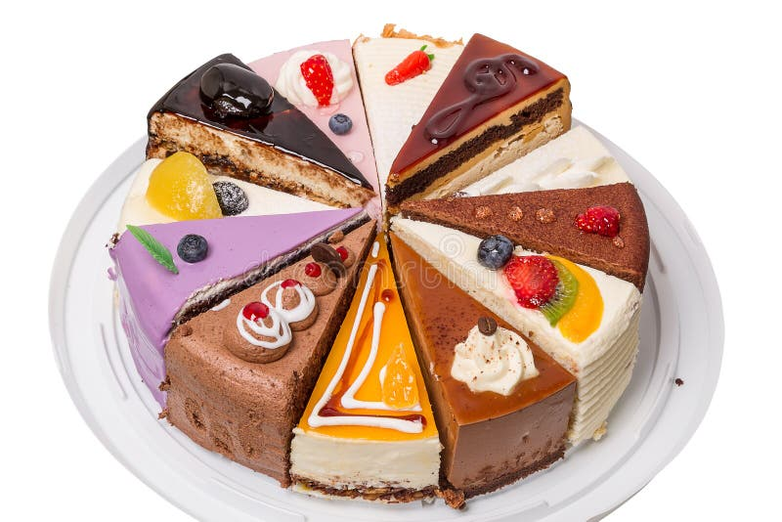
Two pieces of cake
Up until now we’ve been cutting our data-cake into two pieces
Train
Test
There are guidelines on these percentages:
You use this when you have only 1 model
Dataset size | Recommended split | Notes
Large (> 10k samples) | 80/20 or 90/10 | You can afford a small test set
Medium (> 1k samples) | 75/25 or 80/20 | Find a balance
Small (< 1k samples) | 70/30 or cross validation | Test sets may be too small to give a stable estimate

Slide 17
One model
Basic split: Train/Test
In a simple setup:
Training set: Used to train the model.
Test set: Used once at the end to evaluate performance.
This works if you train only one model or do no hyperparameter tuning.
But in real-world model development, that's rarely the case.

Slide 18
Two pieces of cake
Using only two pieces, suppose you do the following:
For(i=1;i<=10;i++)
Tune parameters
Train a model using the train set
Test the model using the train set
Save the model and the parameters
Then this means that the model has seen the test-set 10 times already! We risk overfitting on the test-set, which is exactly what the test-set was trying to prevent

Slide 19
Two three pieces of cake
For(i=1;i<=10;i++)
Tune parameters
Train a model using the train set
Test the model using the validation set
Save the model and the parameters
Test the best model using the test set
This way we get an estimate on how good the model will work on unseen data
Dataset size | Train | Validation | Test | Notes
Large (> 10k samples) | 70-80% | 10-15% | 10-15% | Plenty of data
Medium (> 1k samples) | 60-70% | 15-20% | 15-20% | More tuning -> more validation
Small (< 1k samples) | 80-90% | Use cross validation | 10-20% | No more fixed validation

Slide 20
Multiple models
When comparing models or tuning: Train/Validation/Test
You now have three sets:
Training set: Used to train the models.
Validation set: Used to compare models or tune hyperparameters (like the number of trees in a random forest).
Test set: Used only once at the very end to report the unbiased performance of the chosen model.
Why this is necessary:
If you use the test set for model selection (or tuning), then it's no longer a true test — you're indirectly training on it by choosing what performs best on it. This leads to overfitting to the test set, and your performance estimate becomes optimistically biased.

Slide 21
Stratified split
A stratified split ensures that each class is represented in approximately the same proportions in both the training and test (or validation) sets as in the full dataset.
Suppose you have a binary classification problem:
90% of your samples are class A
10% are class B
If you randomly split your data without stratification, your test set might (by chance) contain very few or no samples from class B, making the model evaluation unreliable or biased.
Stratification guarantees that:
If your full dataset is 90% A and 10% B,
Then both your training and test sets will also be about 90% A and 10% B.

Slide 22
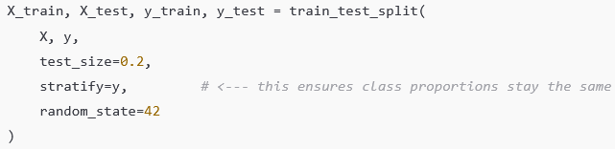
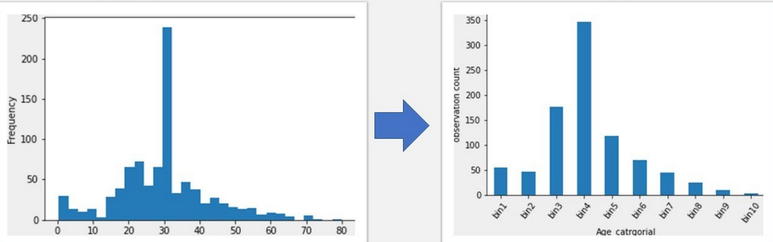
Stratified split
A stratified split should always be used in classification-problems, especially if the classes are imbalanced
Fun fact: we flouted this rule a lot of times in the previous notebooks
But, stratification is only used on classification problems, not regression
You could use binning, but it’s not common

Slide 23
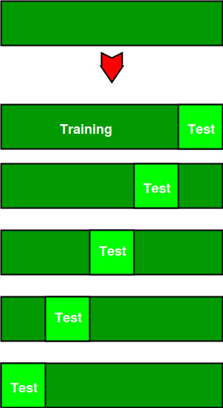
Cross-Validation
When the amount of data is limited, use cross-validation
It is a technique to make sure your model is reliable by testing it on multiple different splits of the data instead of just one.
With cross-validation, we:
Split the data into multiple parts (called folds)
Train the model on some of them
Test the model on the remaining part
Repeat this several times, each time with a different part as the test set
Finally, we average the results to get a more reliable estimate of model performance
Final model: trained on the full dataset
Notes:
https://www.geeksforgeeks.org/cross-validation-machine-learning/

Slide 24
Cross-validation
“So all this effort simply to get a number?”
No! We’re going through all this effort to get several of these numbers
Different models
Different parameters of the same models
We then take the information we learned from this and use that to retrain the final model on the full dataset
As we should always do before deploying a model

Slide 25
Cross-Validation
Benefits
Makes better use of limited data
Gives a more robust estimate of model performance
Helps prevent overfitting to a single train/test split
Downsides
Computationally expensive (it trains the model multiple times)
Unusable for time series (violates causality)
Variance in results (can lead to unstable performance estimates)

Slide 26
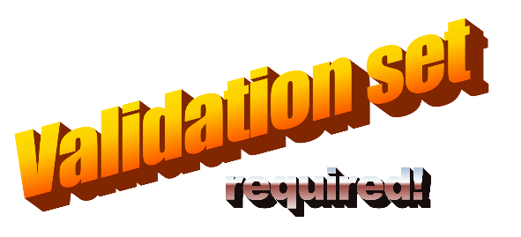
Evaluating AUC-ROC
One model -> one ROC curve -> one number for AUC
More models -> more ROC curves -> compare multiple AUC’s
Same model with different tuning
Or a different model
More models -> more training and testing of models

Slide 27
The models
(finally)
There are a lot of models
We’ll start with the very easy and understandable ones, and stop before it get’s really complicated
Which is a pity, as one could expect these models to be better
But the prerequisites of this course were not “a PHD in mathematics”
Also, even in machine learning deep learning networks are becoming more prevalent, and we have another course for those
The good part: using a difficult model is the same as using an easy one!

Slide 28
An overview of the model
See 6.2 - Model overview.ipynb
(Sometimes a slide simply isn’t big enough)

Slide 29
Classification or regression?
Most models can be used for both classification and regression, despite this not always making sense (like a decision tree)
Can be used for both:
Decision trees, random forest, gradient boosting, XGBoost
Can only be used for classification
Logistic regression
Can only be used for regression
Linear regression

Slide 30
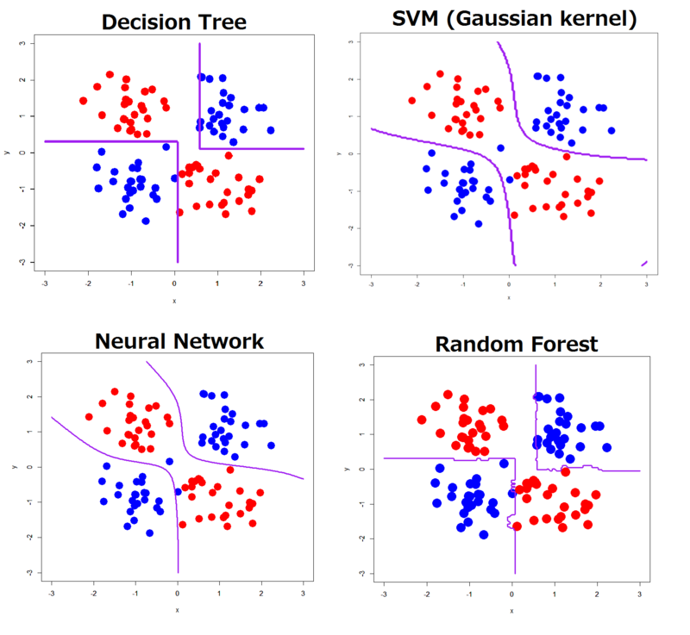
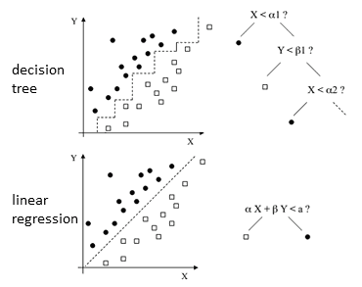
Decision boundary

Slide 31
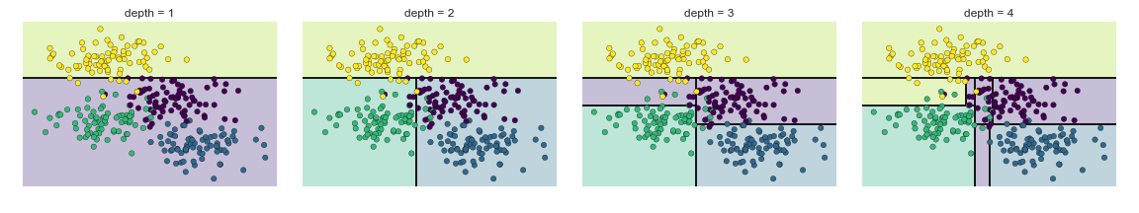
The subtlety of overfitting
Overfitting is a real risk
The left image is underfit, the right one is overfit
This shows overfitting can be a problem even when using simple models
Also, this is overfitting with 2 dimensions, the same works in 17 dimensions
Or 103, when using the yeast dataset

Slide 32
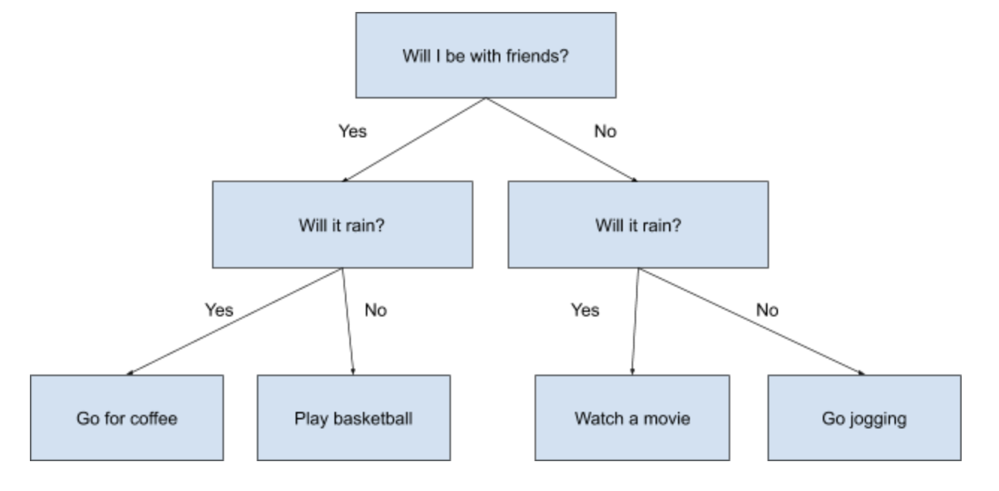
Decision trees
Simple, interpretable models that split data based on feature thresholds. Prone to overfitting.
You ask the model to create a tree with yes/no questions
Depending on the answer you go down one or the other path in the tree
Eventually you end up with a class or decision
Fun fact: the top two rows in this tree are interchangeable

Slide 33
Decision trees
An easy model to train, the best model to explain
You’d say it outputs a hard value for class, but it doesn’t
When a sample reaches a leaf node, it doesn't just get a hard label, it also has access to the class distribution of the training data that ended up in that leaf during training.
For example, imagine a leaf node was trained on 20 samples:
15 were class 0
5 were class 1
The predicted probabilities from that leaf will be 75% and 25%
As we saw in notebook 5.3 (multiclass on wine) the tree you get depends on the input data and the train/test split

Slide 34
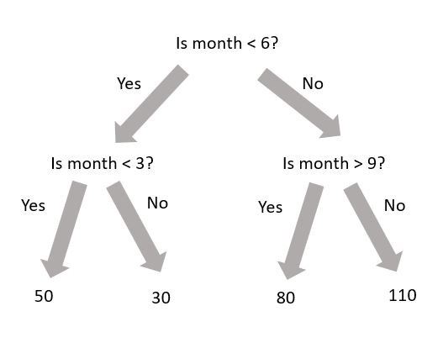
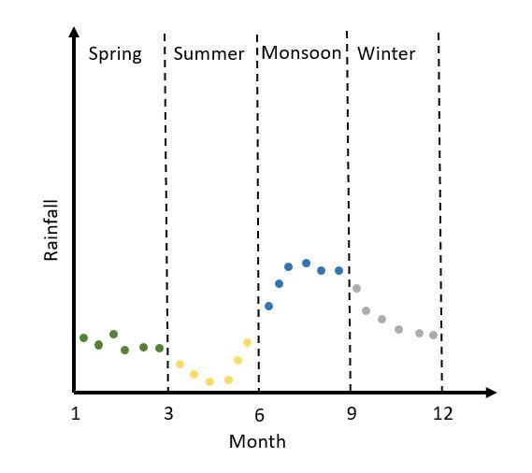
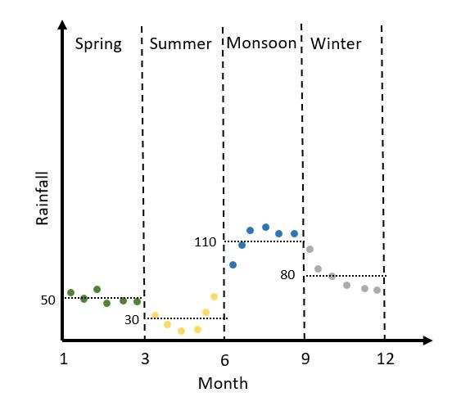
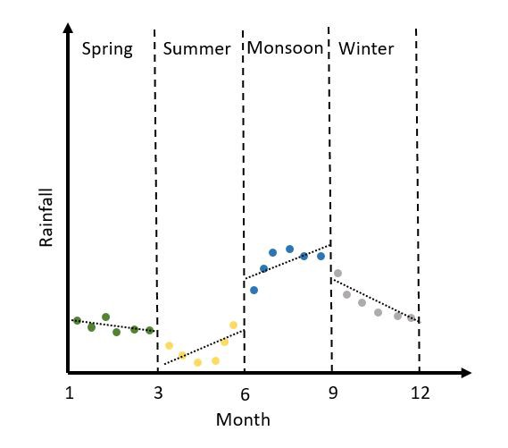
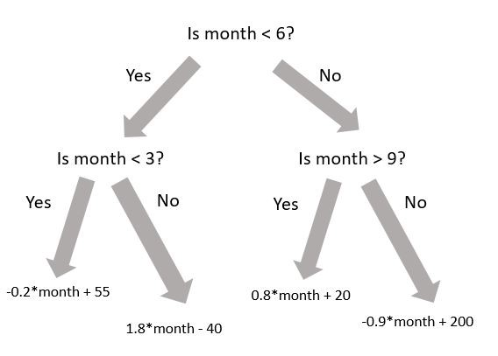
Can decision tree do regression?
Regression predicts a continuous values, but after binning a continuous variable it becomes a categorical variable.
To determine leaf value, you can take average, median, … of the bin. Or get fancy and do a linear regression for the values inside the bin, or…

Slide 35
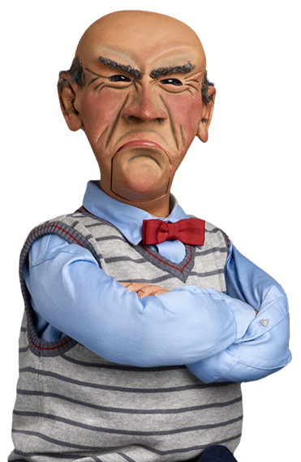
Random forest
One tree is nice, but what if we made 100 trees and combined the results?
But if we simply started from the same data we’d get almost the same tree 100 times…
We’ll train on a random sample of the data and on a random subset of features!
But what if one tree says 1 and the other says 2?
We can combine the results using classification (majority vote) or regression (average the results)

Slide 36
Random forest
By combining many weak, noisy trees, you get a stronger, more stable model.
It reduces overfitting and improves generalization
Analogy
Think of it like asking 100 slightly different experts for their opinion and going with the consensus instead of trusting just one
Also, among them are experts in a couple of the features (random feature selection)

Slide 37
Ensemble learning
When going from decision trees to random forests, we started doing “ensemble learning”
Ensemble methods combine the predictions of multiple models to improve performance
Bagging and boosting are two main strategies
Random forests do bagging
XGBoost does boosting
Stacking is a third way
Train a bunch of different models
Train another model to learn which model to use in which case

Slide 38
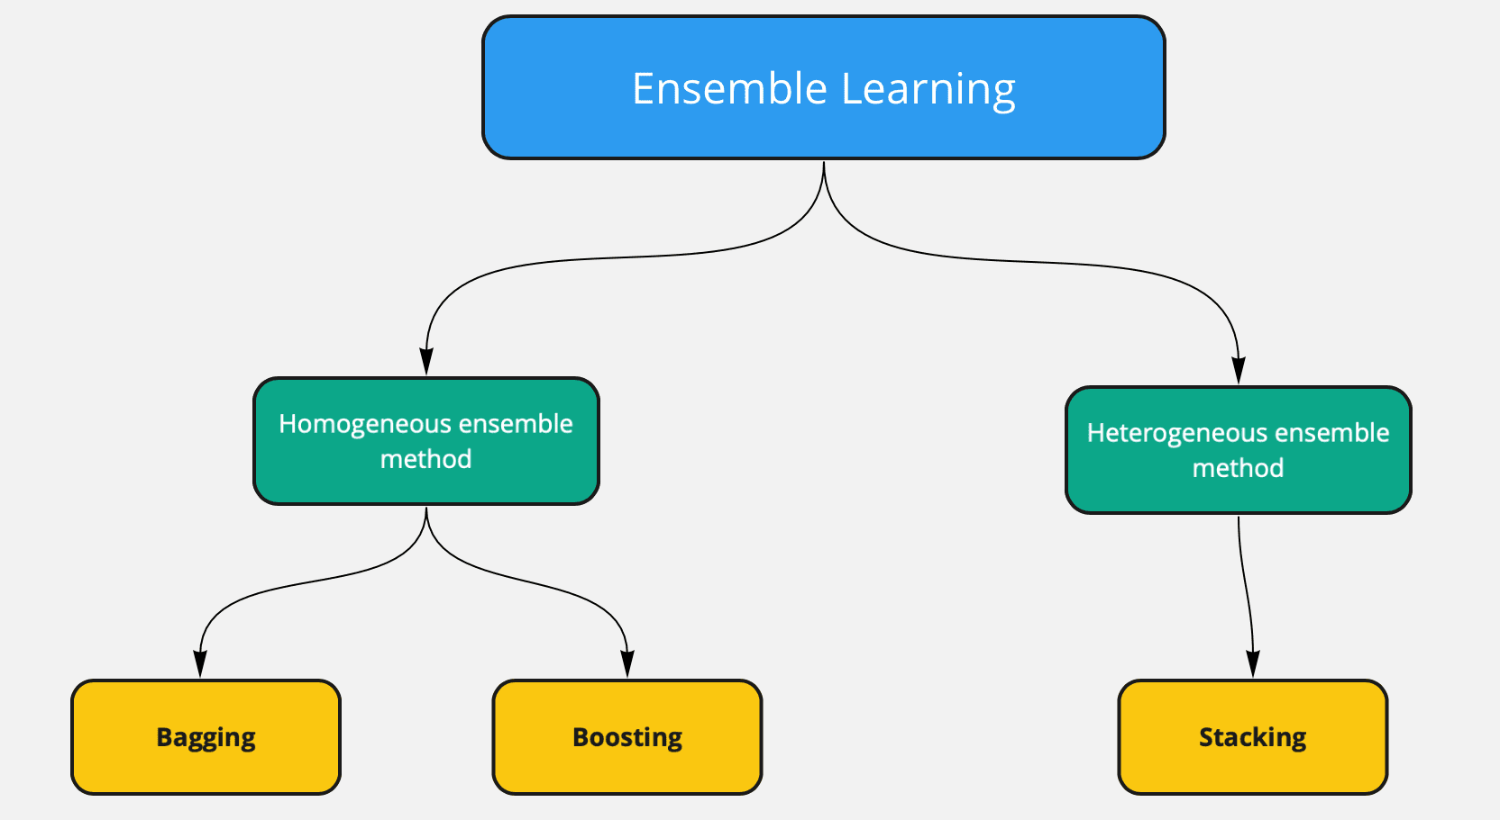
Ensemble learning
The baseline is in all cases: When using ensemble learning we predict the outcome value using a bunch of different methods. Then we combine the outcome of all these algorithms and retain the most voted answer.

Slide 39
Bagging (bootstrap aggregating)
Goal: Reduce variance (overfitting)
How: Train several models in parallel on random subsets of the data
(with replacement = bootstrapping).
Combine: Average (for regression) or majority vote (for classification).
Key idea: Many weak models → One strong model
Random Forest = Bagging + Decision Trees
Each tree is trained on a different bootstrap sample and considers only a random subset of features at each split.

Slide 40

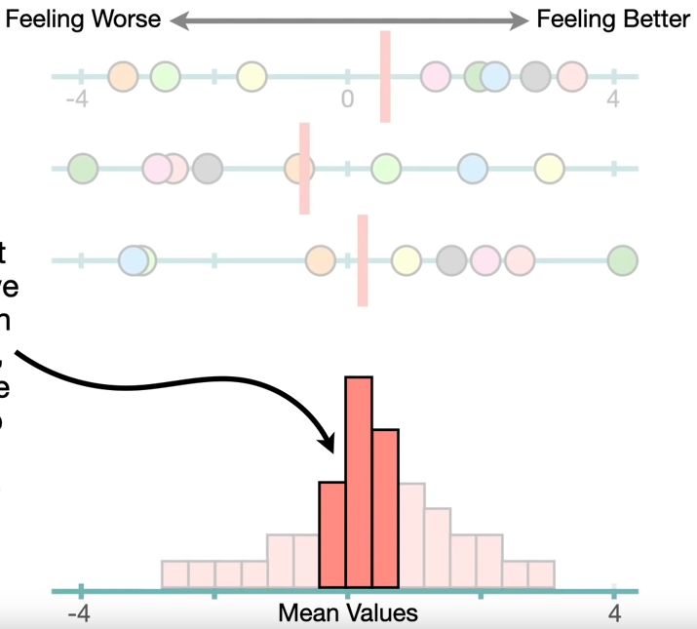
Bootstrapping
If you need more data you can do more experiments, or you can bootstrap your data
Getting more data is expensive and not always possible
Another solution is bootstrapping
Notes:
https://www.youtube.com/watch?v=Xz0x-8-cgaQ&list=TLPQMDgwNTIwMjWHgwGcWK6j_g&index=1

Slide 41
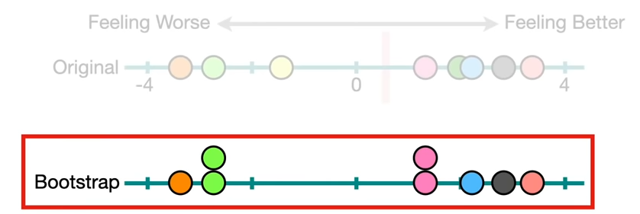
Bootstrapping
We make a new dataset and use ‘sampling with replacement’. This means we copy random values and don’t care if we already copied a value.
This new dataset is called the bootstrap.

Slide 42
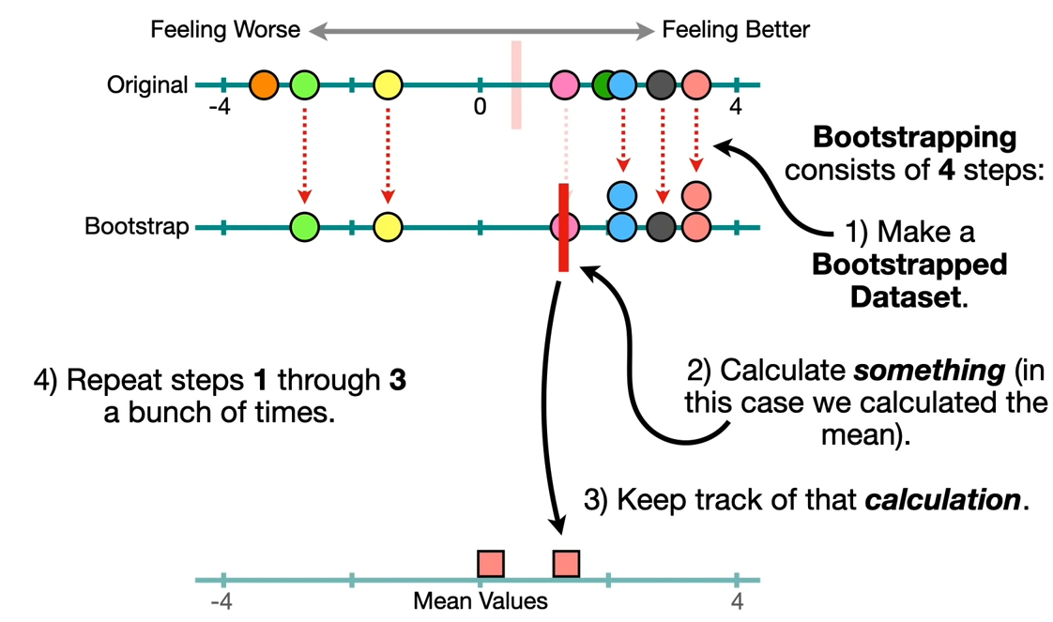
Bootstrapping
… and repeat
This is the process used in random forest, but in stead of calculating the mean it calculates decision trees

Slide 43
Boosting
Goal: Reduce bias (underfitting).
How: Train models sequentially, where each new model focuses on correcting errors made by the previous ones
Combine: Weighted sum of all models
Key idea: Train smarter over time
Examples:
Gradient Boosting
AdaBoost
XGBoost / LightGBM / CatBoost (fast and optimized versions)

Slide 44
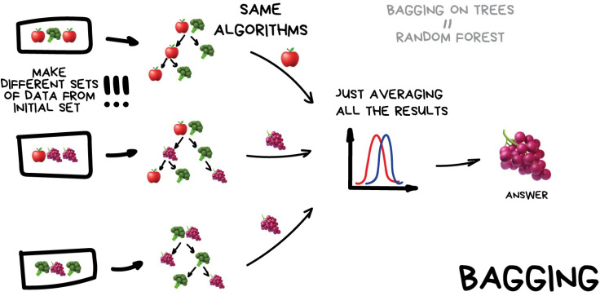
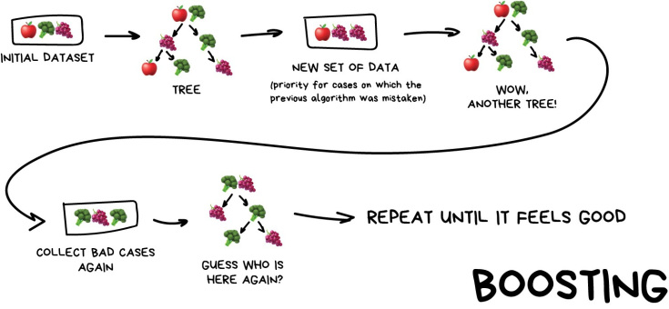
Homogeneous ensemble
Full dataset!*
Notes:
* Full dataset, but modern models such as XGBoost, LightGBM and CatBoost use a subset here and retrain on a different subset taking into account the residual error for the previous set.

Slide 45
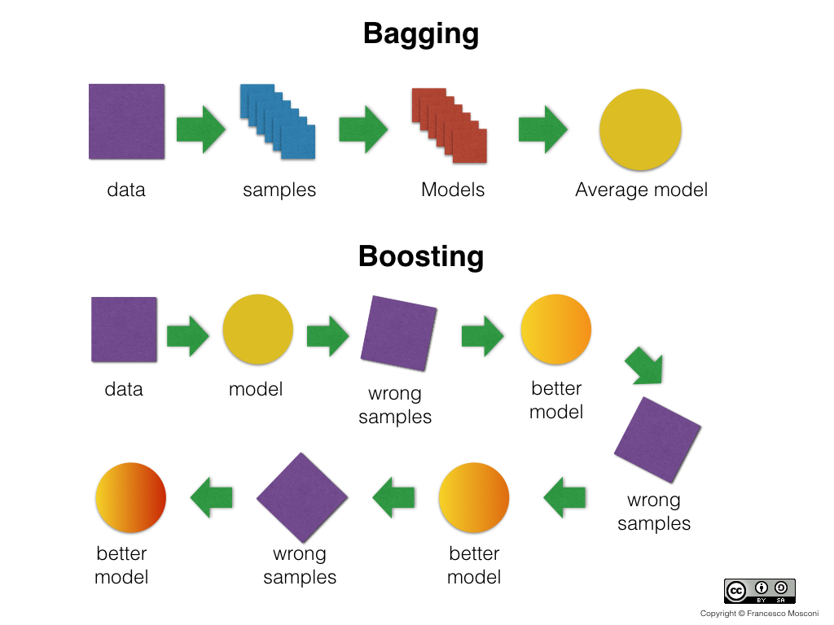
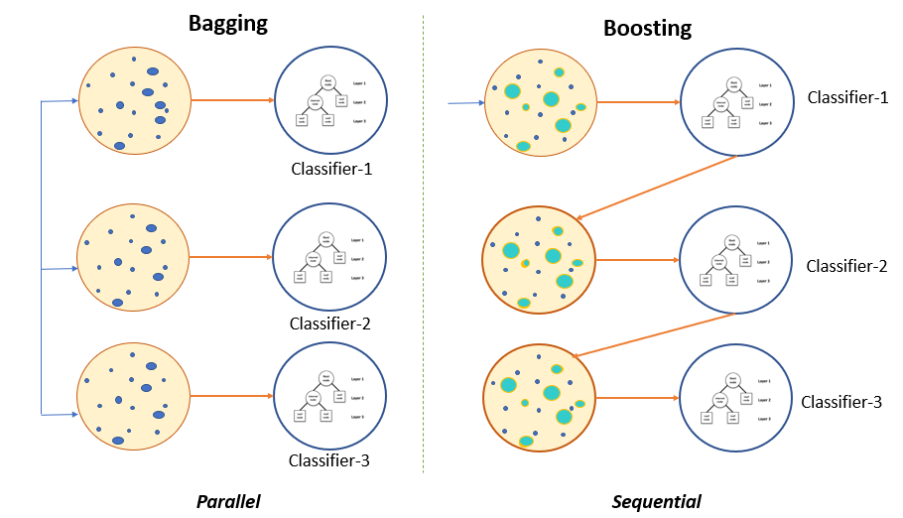
Bagging versus boosting
Independent
weak learner
training
Iterative
weak learner
training

Slide 46
Random forest
RandomForestClassifier
Random forest does bagging using decision trees
It starts with the training set and turns this set into many different data-sets
Based on a random selection of the datapoints
The same datapoints can be used in many sets
All decision trees are calculated
The results are averaged or chosen using majority voting
Sklearn – RandomForestClassifier: majority voting (even when doing regression)
Sklearn – RandomForestRegressor: averaging

Slide 47
Gradient boosting
Bagging is parallel, boosting is in series
Gradient boosting is a machine learning technique that builds a strong model by adding together many weak models, each one correcting the mistakes of the previous ones
Start simple: Begin with a basic model (like a small decision tree)
Check errors: Look at where this model made mistakes
Build a new model: Train another tree to predict the errors (the “residuals”)
Add it to the mix: Add the new model’s prediction to the original one (like a correction)
Repeat: Keep repeating this process

Slide 48

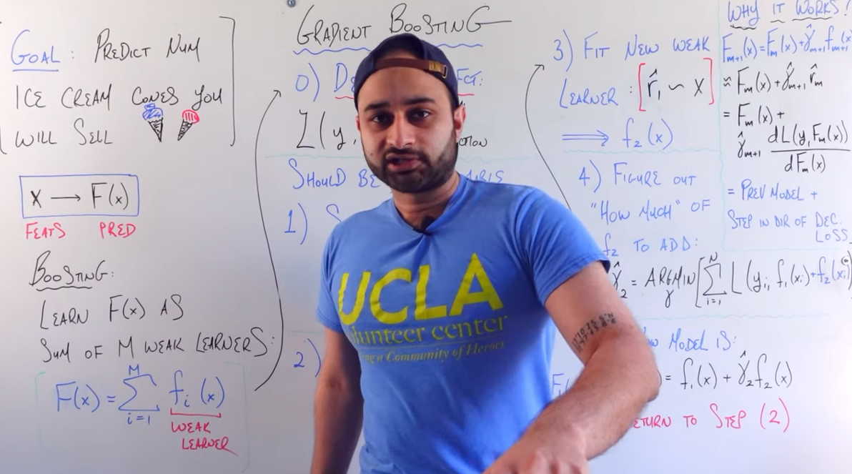
Gradient boosting
Each new model is trained to reduce the loss (like error or log-loss), and this is done using the gradient of the loss function
The loss-function is the calculation of the errors, like the MSE
This you can use to make a better model
But let’s hear more from an expert:
Notes:
https://www.youtube.com/watch?v=en2bmeB4QUo

Slide 49

(As we’re on youtube…)
Notes:
https://www.youtube.com/@MakeitExtreme/videos

Slide 50
eXtreme Gradient Booster
Gradient boosters are good, but eXtreme gradient booster is better!
Designed for maximum performance and flexibility
Feature | Classic gradient boosting | XGBoost
Speed | Slower, especially on large datasets | Much faster with C++ backend and parallelization
Regularization | Basic (or none) | L1 & L2 regularization to prevent overfitting
Missing Values | Must be imputed beforehand | Handles them internally during training
Tree Pruning | Grows full trees, then prunes | Uses “depth-wise” or “loss-guided” tree growth for better accuracy
Parallelization | Sequential tree building | Efficient parallel computation during training
Early Stopping | Manual or partial | Built-in with evaluation sets and scoring

Slide 51
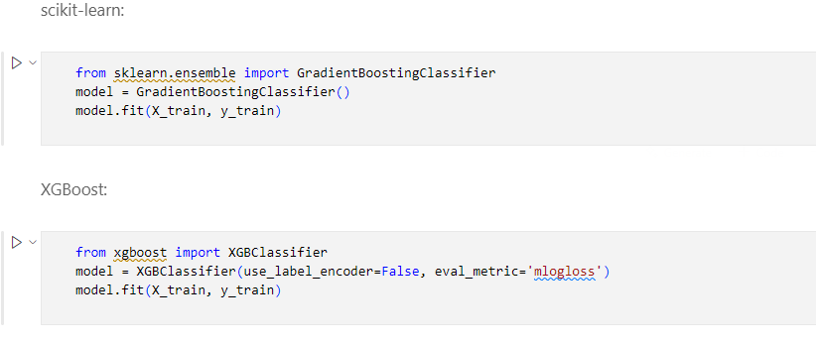
Code comparison
Notes:
Other boosters: LightGBM or CatBoost

Slide 52
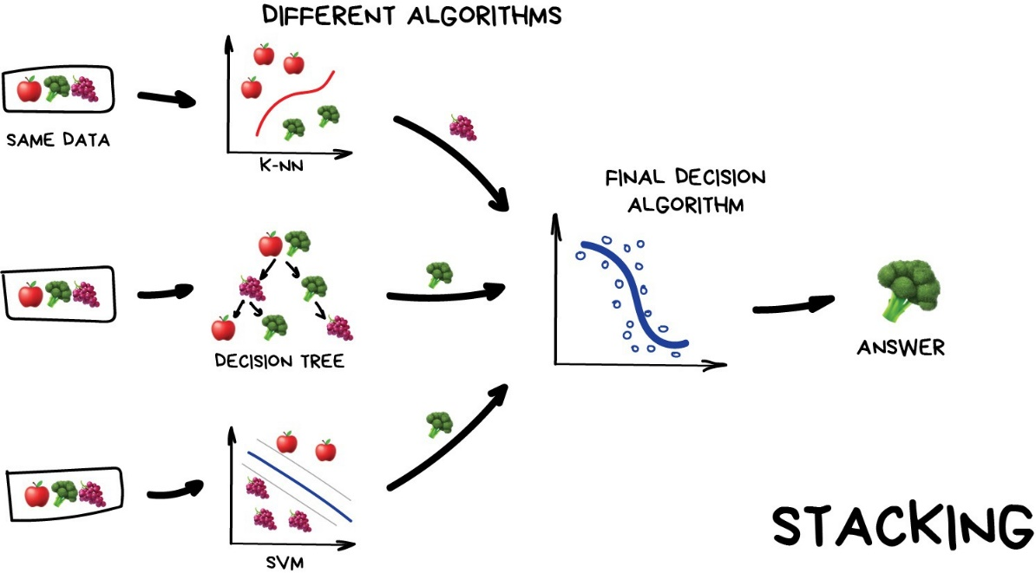
Heterogeneous ensemble
Do one train/test split
You don’t need a validation set because you’re not comparing the models, you’re building and using them concurrently
Give the training data to a bunch of different models
Choose another model as the meta-model
This model will get to make the final decision
Use the test-data to check how great your models working together are!

Slide 53
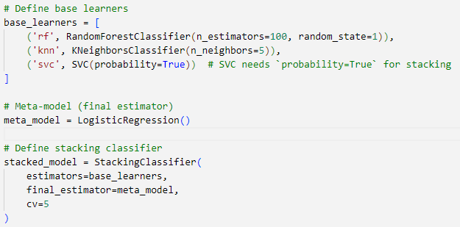
Heterogeneous ensemble
[A bit of code says more than a thousand words]

Slide 54

Linear models
“Now that we've explored tree-based models (flexible, nonlinear, and often opaque), let’s turn to a different class of models: linear models
These are simpler, faster, and easier to interpret, and they can be highly effective when the relationship between input features and the target is linear (or nearly linear)
A linear model assumes a straight-line relationship
Two main types:
Linear regression: predicting continuous values
Logistic regression: for binary (or multi-class) classification

Slide 55
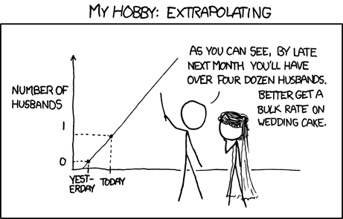
Linear models
Advantages:
Fast to train, works well on high-dimensional data
Easy to interpret (feature weights show importance)
Often a strong baseline model
Limitations:
Struggles with nonlinear relationships
Sensitive to multicollinearity and outliers (though regularization helps)
Notes:
https://xkcd.com/605/

Slide 56
Linear models
Linear models may not be the best predictors, but they have another use case:
The price of a diamond is heavily defined by the weight
Diamonds have a cut as well, and this cut also has a certain influence
Unfortunately, the influence of the price is so big that this relationship disappears completely
We could use a linear model on price vs weight to get this influence out of the dataset
That would enable us to see the actual relationship between cut and price
Check out “3 - Diamonds modeling.ipynb”

Slide 57
Linear Regression
RMSE is essential...
Measures average prediction error
Penalizes large errors (squared)
Great for comparing model performance
...but not the whole story
Concept | Why it matters
Linearity assumption | Model assumes a straight-line relationship — check with residual plots
Residuals | Should be normally distributed, independent, and show constant variance
Multicollinearity | Highly correlated features distort coefficients and reduce model trust
Overfitting | Low RMSE on training ≠ good generalization — use validation!
Regularization | Ridge/Lasso reduce overfitting, especially with many features
Interpretability | Coefficients show relationships; p-values and confidence intervals matter
Data preprocessing | Scaling, outliers, and feature selection all affect results

Slide 58
Support Vector Machines (SVM)
A Support Vector Machine (SVM) is a supervised machine learning algorithm used for classification (mainly) and sometimes for regression tasks
How It Works (Intuitively)
Plot the Data in n-Dimensional Space: Each data point is a vector of features.
Find a Hyperplane: A hyperplane is just a line (2D), plane (3D), or higher-dimensional flat surface that divides the space.
Maximize the Margin: SVM chooses the hyperplane with the greatest distance to the nearest points from either class.
Use the Support Vectors: Only the closest points (support vectors) affect the decision boundary. All others are ignored.

Slide 59
Support Vector Machines (SVM)
Instead of computing dot products in high-dimensional space (which is expensive), the kernel function computes it directly.
Common kernels: Linear, Polynomial, Radial Basis Function (RBF/Gaussian), Sigmoid
Pros:
Works well with high-dimensional data
Effective when there’s a clear margin of separation
Robust to overfitting, especially in high dimensions
Cons
Not great for very large datasets (slow training)
Poor performance when data is highly overlapping
Choice of kernel and hyperparameters can be tricky

Slide 60
Instance based methods
k-Nearest Neighbors (k-NN) is a supervised learning algorithm used for both classification and regression (though it's more commonly used for classification)
A lazy learning algorithm, meaning it doesn’t actually learn a model during training but it stores the training data and makes decisions only at prediction time
How It Works (Intuitively)
Pick a number k — this is the number of neighbors to consider.
Calculate distances between the new (unknown) data point and all training data points (commonly using Euclidean distance).
Find the k closest data points (neighbors).
Vote:
For classification → assign the majority class among the neighbors.
For regression → return the average value of the neighbors.

Slide 61
Instance based methods - kNN
Example: Suppose you're trying to classify a fruit as an apple or an orange, based on its weight and color
If k=3, the algorithm will:
Look at the 3 closest fruits in your dataset
If 2 are apples and 1 is an orange → predict apple
Choosing k
Small k (e.g. 1) → sensitive to noise (overfitting).
Large k → smoother decision boundaries but may underfit.
Typically, odd k values are used to avoid ties in binary classification.

Slide 62
Instance based methods - kNN
Pros
Simple and intuitive
No training phase — fast to set up
Works well with small datasets and well-separated classes
Cons
Slow at prediction time for large datasets (needs to compare to all points)
Sensitive to irrelevant or unscaled features
Poor performance in high-dimensional spaces (curse of dimensionality)

Slide 63

Naive Bayes
Naive Bayes is a supervised learning algorithm based on Bayes’ Theorem, used primarily for classification tasks
Bayes: because it relies on Bayes’ Theorem
Naive: because it assumes that features are independent given the class (which is almost never true in practice, but it works surprisingly well)
How it works:
P(Class | Features): What we want (posterior).
P(Features | Class): Likelihood — how typical the features are for this class.
P(Class): Prior — how common this class is overall.
P(Features): Same for all classes, so can be ignored when comparing.

Slide 64
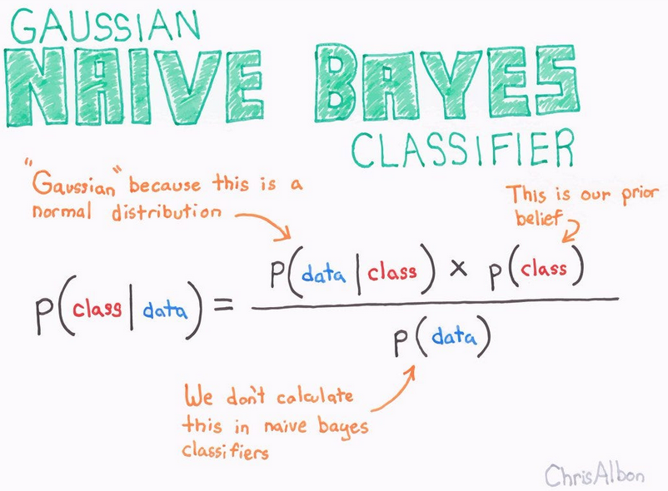
Naive Bayes
Let’s say you’re building a spam detector:
Features: presence of certain words (“free”, “win”, etc.) to classify “Spam” vs “Not spam”
Naive Bayes:
Learns how often words appear in spam and non-spam emails.
Given a new email, it multiplies the probabilities of the observed words per class and picks the most probable class.
Pros
Very fast to train and predict
Works well with high-dimensional data (e.g., text)
Robust to irrelevant features
Requires very little training data
Cons
Assumes feature independence, which is rarely true
Doesn’t work well with correlated features
Struggles when data is imbalanced without adjustments

Slide 65
Comparing the “extra” models
Feature / Algorithm | SVM | k-NN | Naive Bayes
Type | Supervised, model-based | Supervised, instance-based | Supervised, probabilistic
Training Time | Medium to High | None (lazy learner) | Very Fast
Prediction Time | Fast (after training) | Slow (especially with large data) | Very Fast
Memory Usage | Low (stores model) | High (stores all training data) | Low
Handles High Dimensions | Yes | No (curse of dimensionality) | Yes
Interpretable? | Medium | Yes (examples are real data) | Yes (probabilities, priors)
Assumptions | Margin-based, assumes separability | Similarity in space | Feature independence
Sensitive to Outliers | Yes | Yes | Not very
Handles Categorical Data | No (needs encoding) | Yes (with preprocessing) | Yes (especially good with it)
Best Use Case | Clear margin between classes | Low-dimension, simple problems | Text classification, spam filtering

Slide 66
Summary
We did the tree-models
Decision trees, random forest, gradient booster
Also bagging, boosting, bootstrapping and stacking
Then we did some linear models
Just linear regression, but when you understand RMSE there’s not much more to learn
We can’t do neural networks
Is reserved for the next course
Stealing course material is severely looked down on among teachers
We glossed over the special cases
SVM, kNN and Naïve Bayes
Clustering and time series are for a later chapter

